Slide 1
Week 11: Exploratory Data Analysis (EDA)
Course: Business Data Analysis (MGT-174)
Week 11 | Exploratory Data Analysis
Instructor: Dr. Muhammad Usman Bhutta

Slide 2
EDA?
Exploratory data analysis (EDA) is used by data scientists to analyze and investigate data sets and summarize their main characteristics, often employing data visualization methods.
EDA helps determine how best to manipulate data sources to get the answers you need, making it easier for data scientists to discover patterns, spot anomalies, test a hypothesis, or check assumptions.

Slide 3
EDA?
EDA is primarily used to see what data can reveal beyond the formal hypothesis testing task and provides a provides a better understanding of data set variables and the relationships between them.
It can help determine if the statistical techniques you are considering for data analysis are appropriate.

Slide 4
EDA in Business Context
Business decisions depend heavily on data insights.
EDA allows managers to understand trends, outliers, and customer behavior from the data.

Slide 5
Core Objectives of EDA
Understand data structure and distribution.
Detect anomalies and outliers.
Test assumptions and generate hypotheses.
Select features for modeling.
Using correlations analysis, variance, missing values.

Slide 6
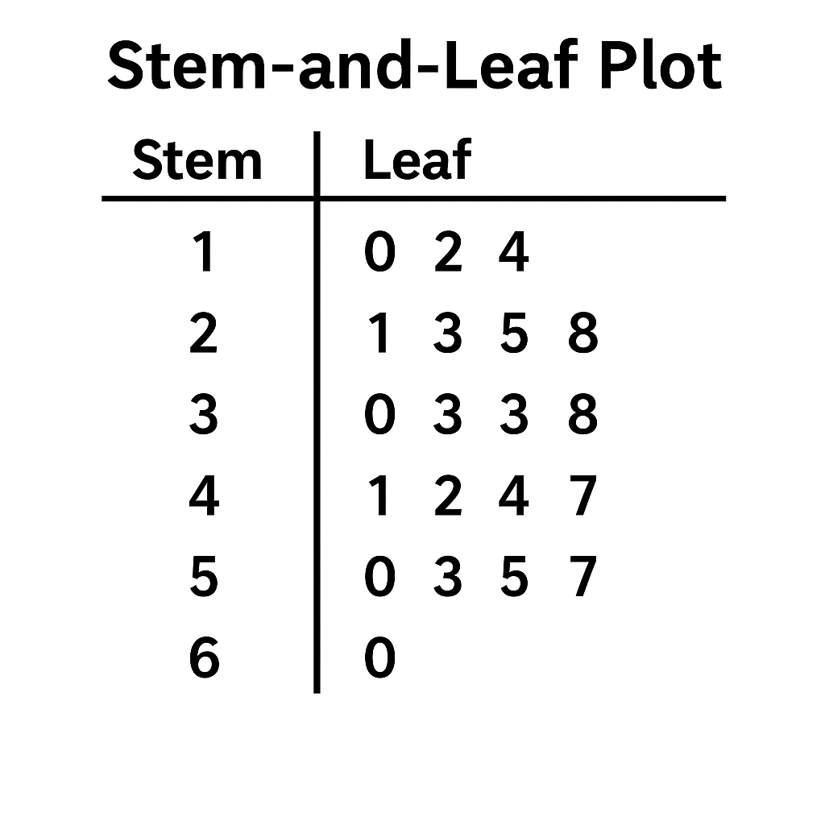
Types of EDA
Univariate Analysis: Examines single variables.
Bivariate Analysis: Examines relationships between two variables.
Multivariate Analysis: Examines complex relationships between more than two variables.
Notes:
When is it useful?
When you want to quickly see the shape (like skewness or symmetry) of small datasets.
When you want a histogram-like view without losing exact values.

Slide 7
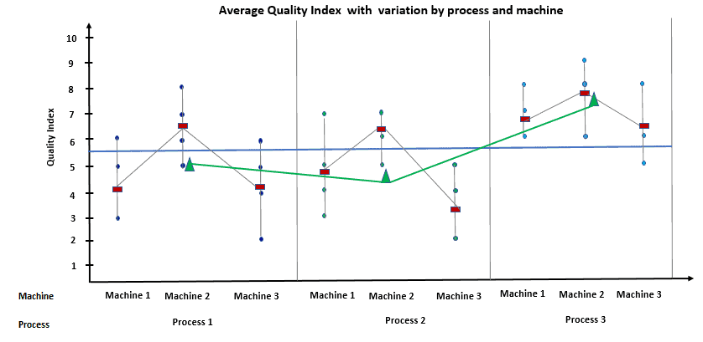
Multi-Vari Chart

Slide 8
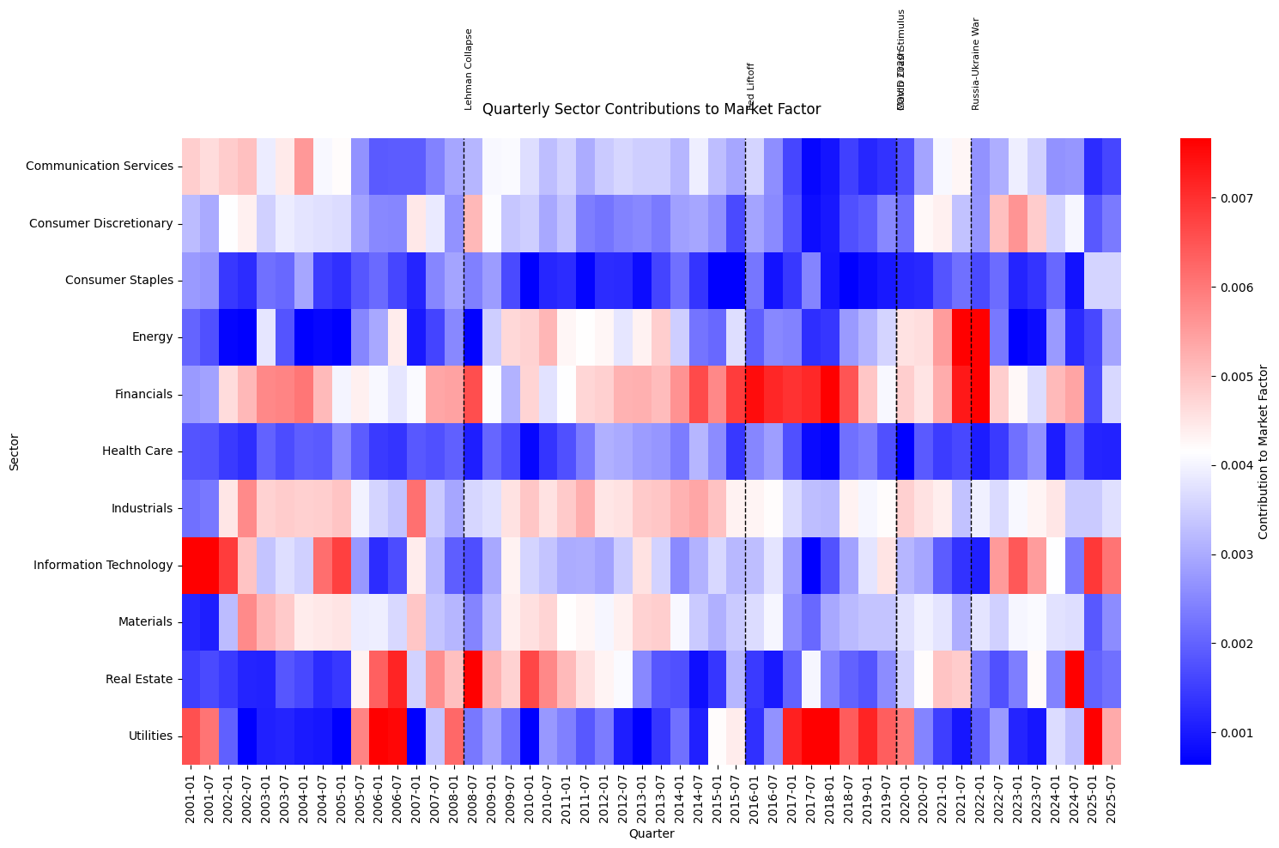
Heatmaps
Histograms show the frequency distribution of continuous variables.
They help detect skewness and kurtosis.

Slide 9
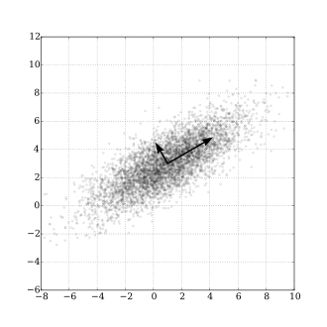
PCA
Boxplots summarize five-number statistics: min, Q1, median, Q3, max.
Useful for spotting outliers and spread.

Slide 10
Median polish
Extract :
Overall median
Row median
Column median
Continue until residuals stabilize-close to zero
Notes:
Thus far, we have assumed an additive relationship between the effects (factors). But this additive model may not be the best fit for our data. A good way to test this is by generating a Tukey Additivity Plot where we plot residuals vs. the comparison value, cvij, defined as αiβj/μ. If the plot is devoid of any obvious trend or pattern we can conclude that our dataset is consistent with an additive model. Such seems to be the case with our working example as shown in the following plot.

Slide 11
Multivariate Analysis – Correlation
Correlation measures linear relationships between numeric variables.
Use df.corr() or sns.heatmap() to visualize correlation matrix.

Slide 12
K-mean clustering
- What is Clustering?
- Introduction to K-Means
- Algorithm Steps
- Example Use Cases
Notes:
This slide gives an overview of what we will cover in this presentation. It introduces the clustering concept, dives into K-means, and outlines the process and practical uses.

Slide 13
What is Clustering?
- Grouping data points based on similarity
KMEANS clustering
Notes:
Clustering is an machine learning technique used to group data based on inherent similarities. This slide introduces the main types of clustering algorithms.

Slide 14
K-Means Clustering
- Partitional clustering technique
- Divides data into K non-overlapping clusters
- Each point belongs to the nearest centroid
Notes:
K-means aims to minimize the within-cluster variance. It’s popular due to its simplicity and efficiency, especially for large datasets.

Slide 15
How K-Means Works
1. Choose K
2. Initialize centroids
3. Assign points to nearest centroid
4. Recompute centroids
5. Repeat until convergence
Notes:
1. Choose K (number of clusters)
Goal: Decide how many clusters you want to find in the data.
This is a hyperparameter you set beforehand.
It determines how many centroids (cluster centers) will be initialized.
🔍 Tip: Use methods like:
Elbow method: Look for a point where adding more clusters doesn’t reduce within-cluster variance significantly.
Silhouette score: Measures how similar a point is to its own cluster vs. others.
Gap statistic: Compares the performance of clustering on real vs. random data.
2. Initialize K Centroids
Randomly select K data points as initial centroids.
Each centroid represents the center of a potential cluster.
Poor initialization can lead to bad convergence or suboptimal clusters.
🔧 Alternative: Use KMeans++, which spreads out the initial centroids to improve results.
3. Assign Points to Nearest Centroid
For each data point:
Compute the distance to each centroid (usually Euclidean distance).
Assign the point to the closest centroid.
This step forms K clusters, where each cluster contains points nearest to its centroid.
4. Recompute Centroids
For each of the K clusters:
Compute the mean (average) of all points assigned to that cluster.
This new mean becomes the updated centroid.
Intuition: The centroid moves to the "center of mass" of its current cluster.
5. Repeat Until Convergence
Go back to Step 3 and repeat the process with the updated centroids.
Convergence criteria:
Cluster assignments don’t change anymore, or
Centroids stop moving significantly, or
A maximum number of iterations is reached.
At this point, the algorithm terminates and returns:
Final centroids,
Cluster assignments for each point.

Slide 16
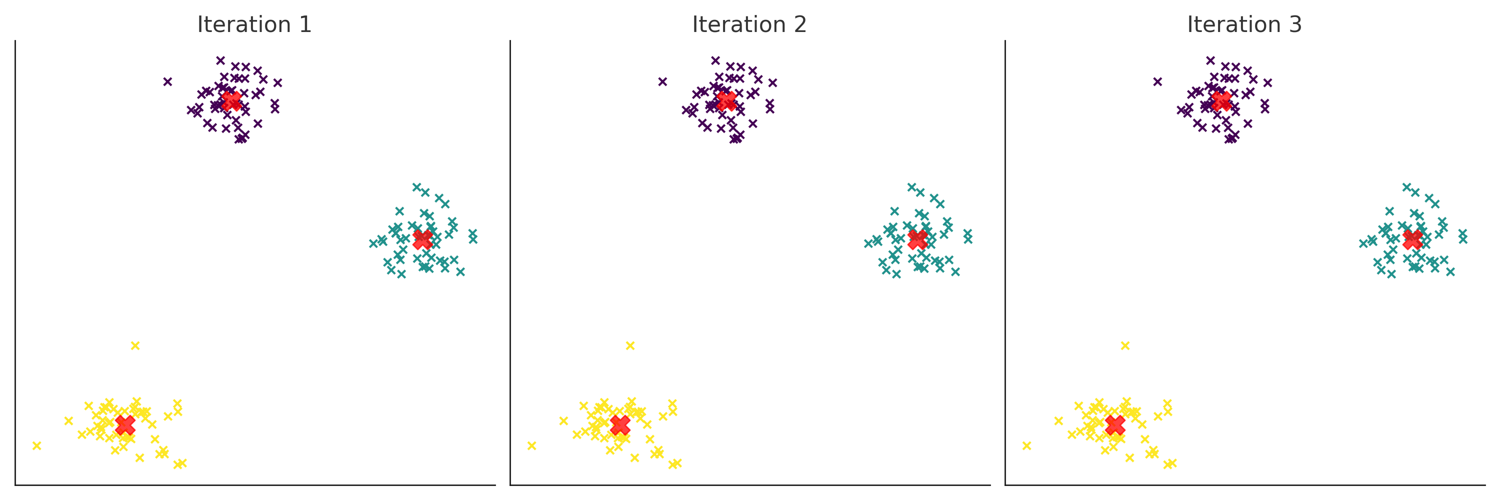
Visual Example
[Add diagram showing K-Means clustering in 3 iterations]
Notes:
This slide would benefit from a visual showing how points are clustered step-by-step. Highlight initial centroids, assignments, and updates over iterations.

Slide 17
Example Use Cases
- Customer segmentation
- Image compression
- Market basket analysis
Notes:
These real-world applications show the versatility of K-means in both structured and unstructured data analysis.

